Slide 1
Play Store Trends and Predictions
By: Sarth Desai and Crystal Cheung

Slide 2
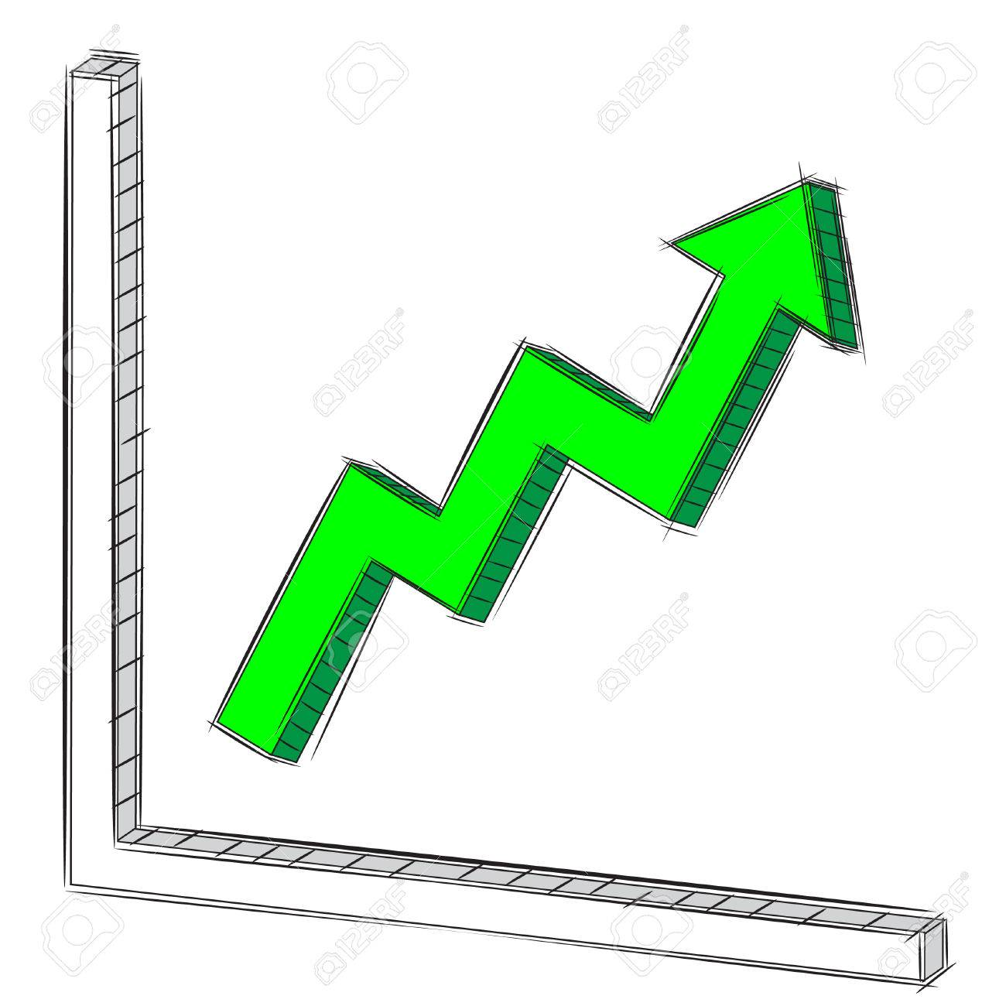
Opportunity
3.3 Billion smartphone users in the world
250 Million downloads per day and increasing
$39.7 Billion in revenue made from apps worldwide
If your app becomes that popular and manages to procure 1 Million downloads, then you can earn between $10000 to $15000 per month
Notes:
https://www.businessofapps.com/data/app-statistics/
https://appinventiv.com/blog/google-play-store-statistics/

Slide 3
Competition
2,714,499 apps on the Google Play Store
3739 apps added daily
Older statistics indicate that 80 percent of developers don’t earn enough to turn their development into viable businesses
App store discoverability is at its lowest,
US users use an estimated 20.1 apps per month in 2019
The number of obsolete apps removed by Google from the Play Store was near to 700,000.
Notes:
https://venturebeat.com/2017/09/24/your-chances-of-making-a-successful-mobile-app-are-almost-nil/
https://dev.to/francisisberto/are-apps-all-dead-9o0

Slide 4

Solution
Find trends in the Google Play Store to find correlation between app attributes and success and ratings
Predict app success and ratings based on:
App size
Category
Number of Reviews
Price
Genres
Content Rating
Prediction Models:
Linear Regression
Gradient Boosting Machine
Distributed Random Forest
Mean Absolute Error: 0.3530

Slide 5
Architecture
Data Source - Kaggle
Storage - MongoDB
Compute - Apache Spark
Display Results - Pandas, Matplotlib, Seaborn
Machine Learning - Spark ML Library, H2O.ai
Notes:
We chose Apache Spark to do computations on our data because it is a powerful platform that is able to process the data and find useful attributes based on calculations done on the data. Spark is distributed and therefore makes it scalable for big data.
We decided to use Spark MLlib because we can compute on the data and run machine learning algorithms in the same place. Spark MLlib, as an extension to spark, is distributed and suitable for processing big data.

Slide 6







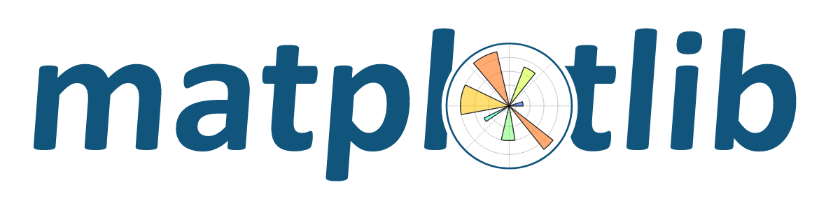
Notes:
We collected data from kaggle and import it into mongoDB where it can be stored permanently, along with out findings and output from doing computations on the data. Pyspark will be used to transform the data frame that holds the data that was originally in the database. Aggregated statistics of the data was displayed using pandas and matplotlib. PySpark ML was used to perform machine learning algorithms on cleaned up data from PySpark.

Slide 7
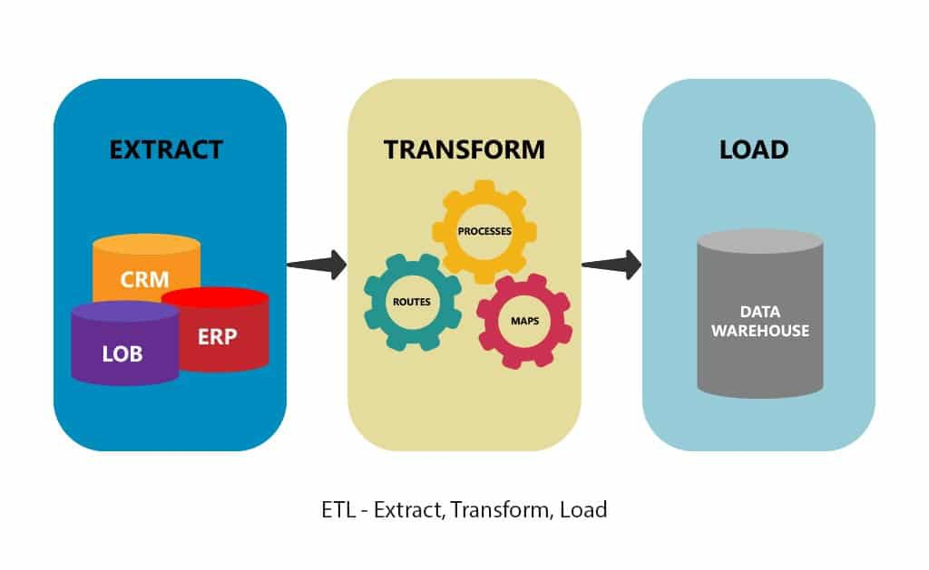
ETL Process
Extract data from Kaggle API
Data Cleaning for Trend Finding
Convert column types
Remove inaccurate data points
Remove NULL values
Preparation for Machine Learning Algorithms
Assigning numerical values to all columns
Convert column types
Vectorizing data

Slide 8
Insights
Barrier to entry for all categories is present because the median is lower than the mean downloads
A few apps in each category is dominating the market and pulling the average higher than the median
Competition is high in the Family and Medical categories
Family category contains the most apps by far, yet its average and median app installs are comparatively much lower
The Medical category shows up in the top 5 categories with most apps in them, yet its average and median installs don’t even rank top 20 highest out of all categories
There are many game apps but its average and median installs are high too
A lot of competition but high return as well
Art and Design category contains a very small number of apps but rank comparatively higher in average and median installs

Slide 9
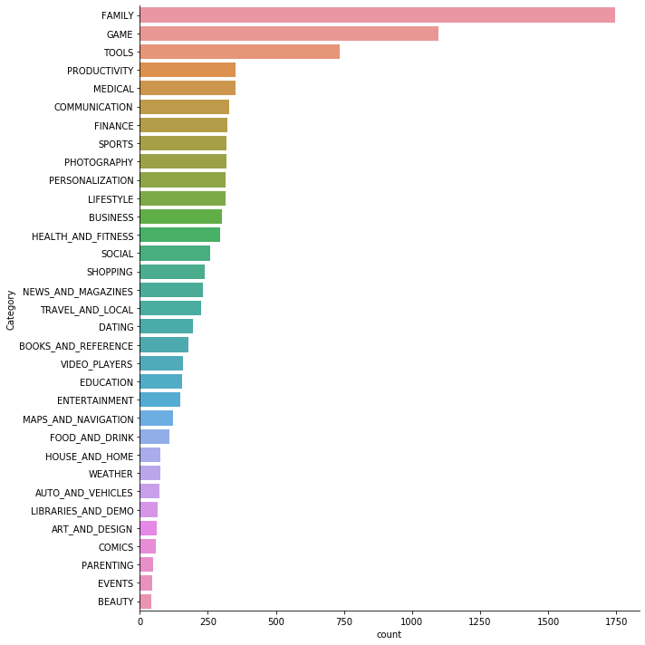
Distribution of Apps in each Category
Notes:
Family has a lot of competition and not many downloads

Slide 10
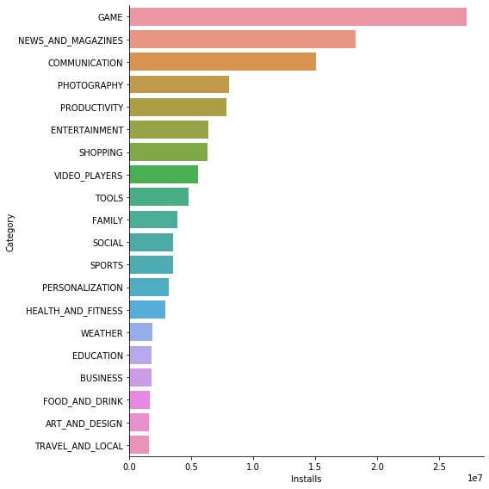
Average Number of Downloads per Category
Notes:
Only showing top 20 categories, news and magazines high average download but low app distribution

Slide 11
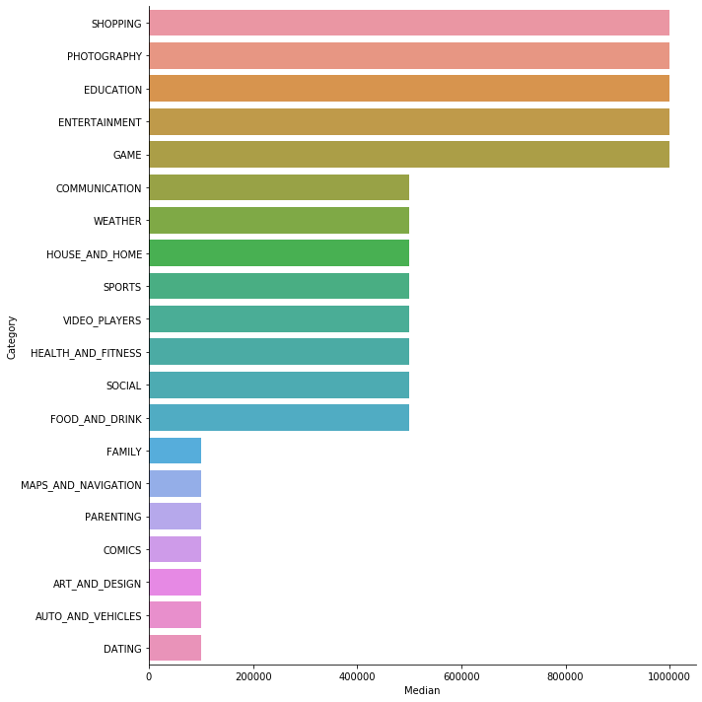
Median Downloads Per Category
Notes:
Only top 20 are shown
Barrier for entry for all categories are high
Education has low average but high median, so most apps are unpopular, so it would be relatively easy to make one that disrupts the market

Slide 12
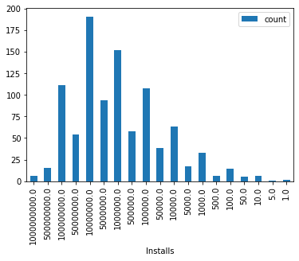
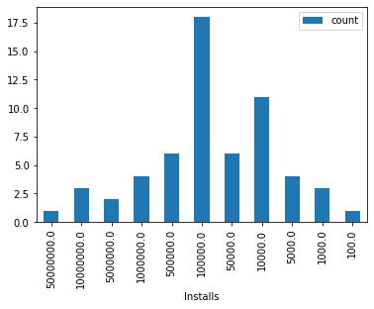
Deeper Look
Category: Games
Category: Art and Design

Slide 13
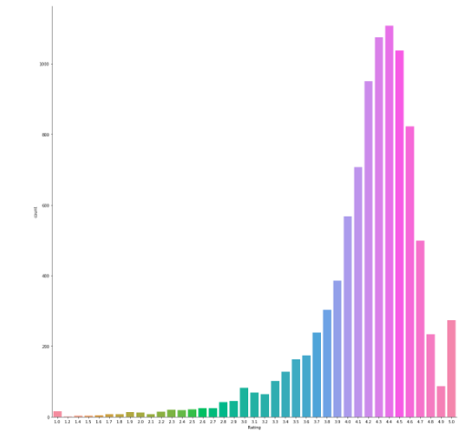
Count of each Rating

Slide 14
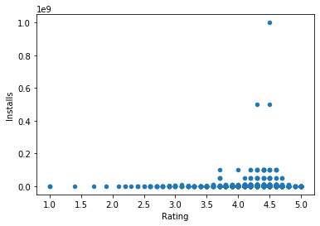
Ratings vs Installs Scatter Plot
Notes:
Direct relationship between installs and ratings, took at sample of 1000

Slide 15
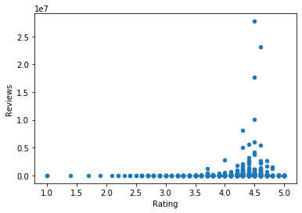
Rating vs Number of Reviews Scatter Plot

Slide 16
Linear Regression
Independent Variables:
Installs
Ratings
Used cross validation and k-folding to find the most accurate models
Results:
Predicting installs, taking into account ratings, Mean Absolute Error: 8313754.175
Predicting installs, not taking into account ratings, Mean Absolute Error: 13359219.498
Predicting ratings, taking into account installs, Mean Absolute Error: 0.3810
Predicting ratings, not taking into account installs, Mean Absolute Error: 0.3784
Dropped predicting installs due to high error rate
Ratings and installs are highly correlated, since accuracy of the prediction went up when ratings were taken into account.
Notes:
We decided to use linear regression because it tracks the relationship between an independent variable and one or more dependent variables.
Use ratings to indirectly determine success of the app

Slide 17
Gradient Boosting Machine (Gaussian distribution)
Gradient Boosting Machine is a forward learning ensemble method.
The guiding heuristic is that good predictive results can be obtained through increasingly refined approximations.
Features:
Number of trees: 50
Results:
Predicting ratings, Mean Absolute Error: 0.3552

Slide 18
Distributed Random Forest
Distributed Random Forest (DRF) is a powerful Classification and Regression tool. It takes the average of the prediction of all the trees to make a final prediction.
Features:
Number of trees: 50
Results:
Predicting ratings, Mean Absolute Error: 0.3530

Slide 19
Conclusion
Important Features are:
Reviews
Size
Installs
Genres
Easiest way to develop a successful app is in the Games or Art and Design category.
Creating a medical or family oriented app would more likely lead to a failure.
We were able to achieve Scalability and Runtime Efficiency for this project by implementing SparkML and H2O for our machine learning models.
Notes:
Installs per category

Slide 20

Future Scope
Look for more representative datasets with useful attributes
Split data up by age group and analyze data by age group
Split data by year so old data does not pollute new trends
Find better machine learning models or tune existing ones for better performance
Implement Kafka when we are able to obtain real time downloads data
Notes:
The current dataset used may not be a representative sample of the app store environment.

Slide 21


